Slide 1
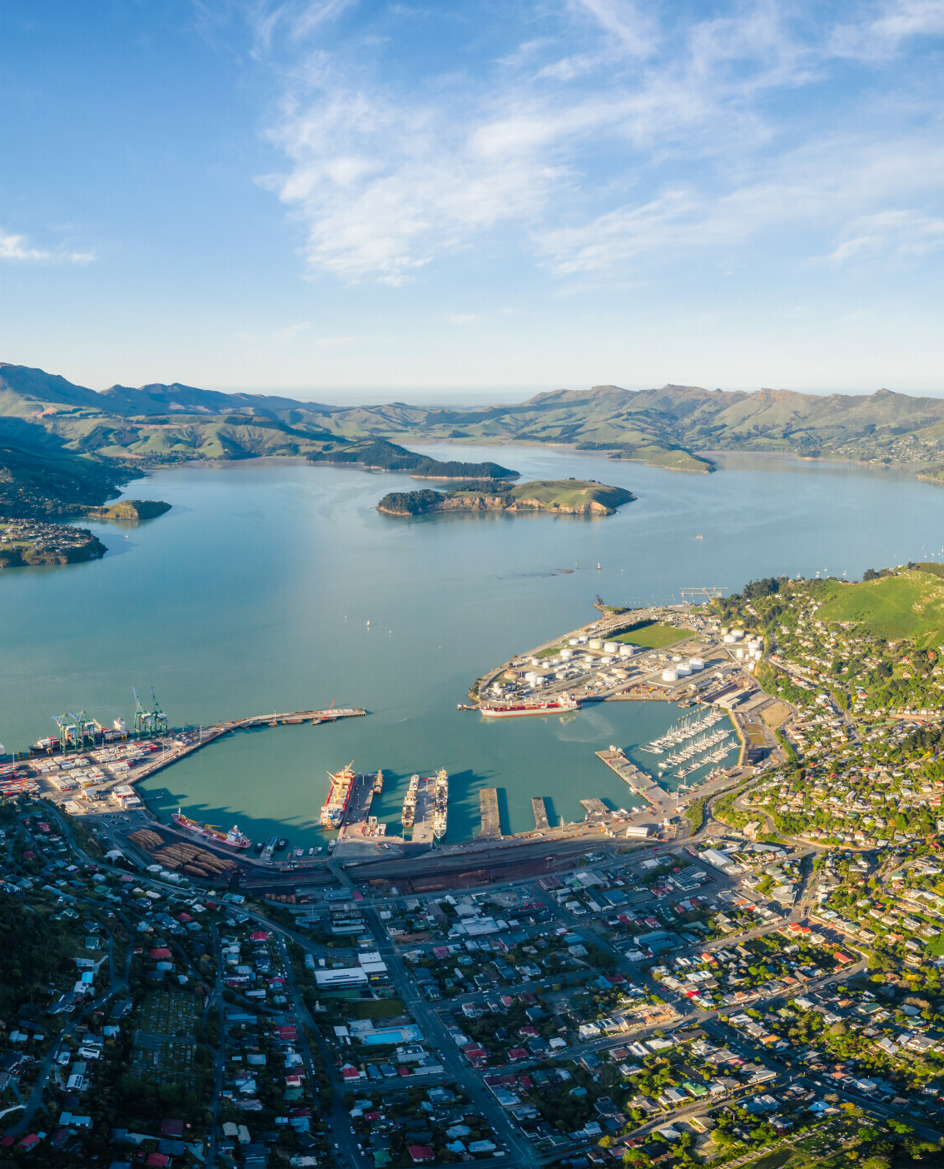
New Zealand’s new planning system
An overview of how the system works, what changes first and what happens next​
September 2026

Slide 2
The new planning system is now in place
Planning Act and Natural Environment Act enacted
Replacing the Resource Management Act framework.
Establishing a simpler, faster and more consistent planning system.
Supporting housing, infrastructure and economic growth while protecting what matters most.
Beginning a phased transition to full implementation.

Slide 3
Why the system is changing
Planning Act and Natural Environment Act enacted
The previous system became increasingly complex
Planning rules, plans and consenting processes became harder to understand and navigate.
Similar issues were often revisited multiple times through plans and consent processes.
Greater consistency, certainty and clarity are needed across New Zealand.
The new system is designed to support growth, productivity and better long-term outcomes.

Slide 4
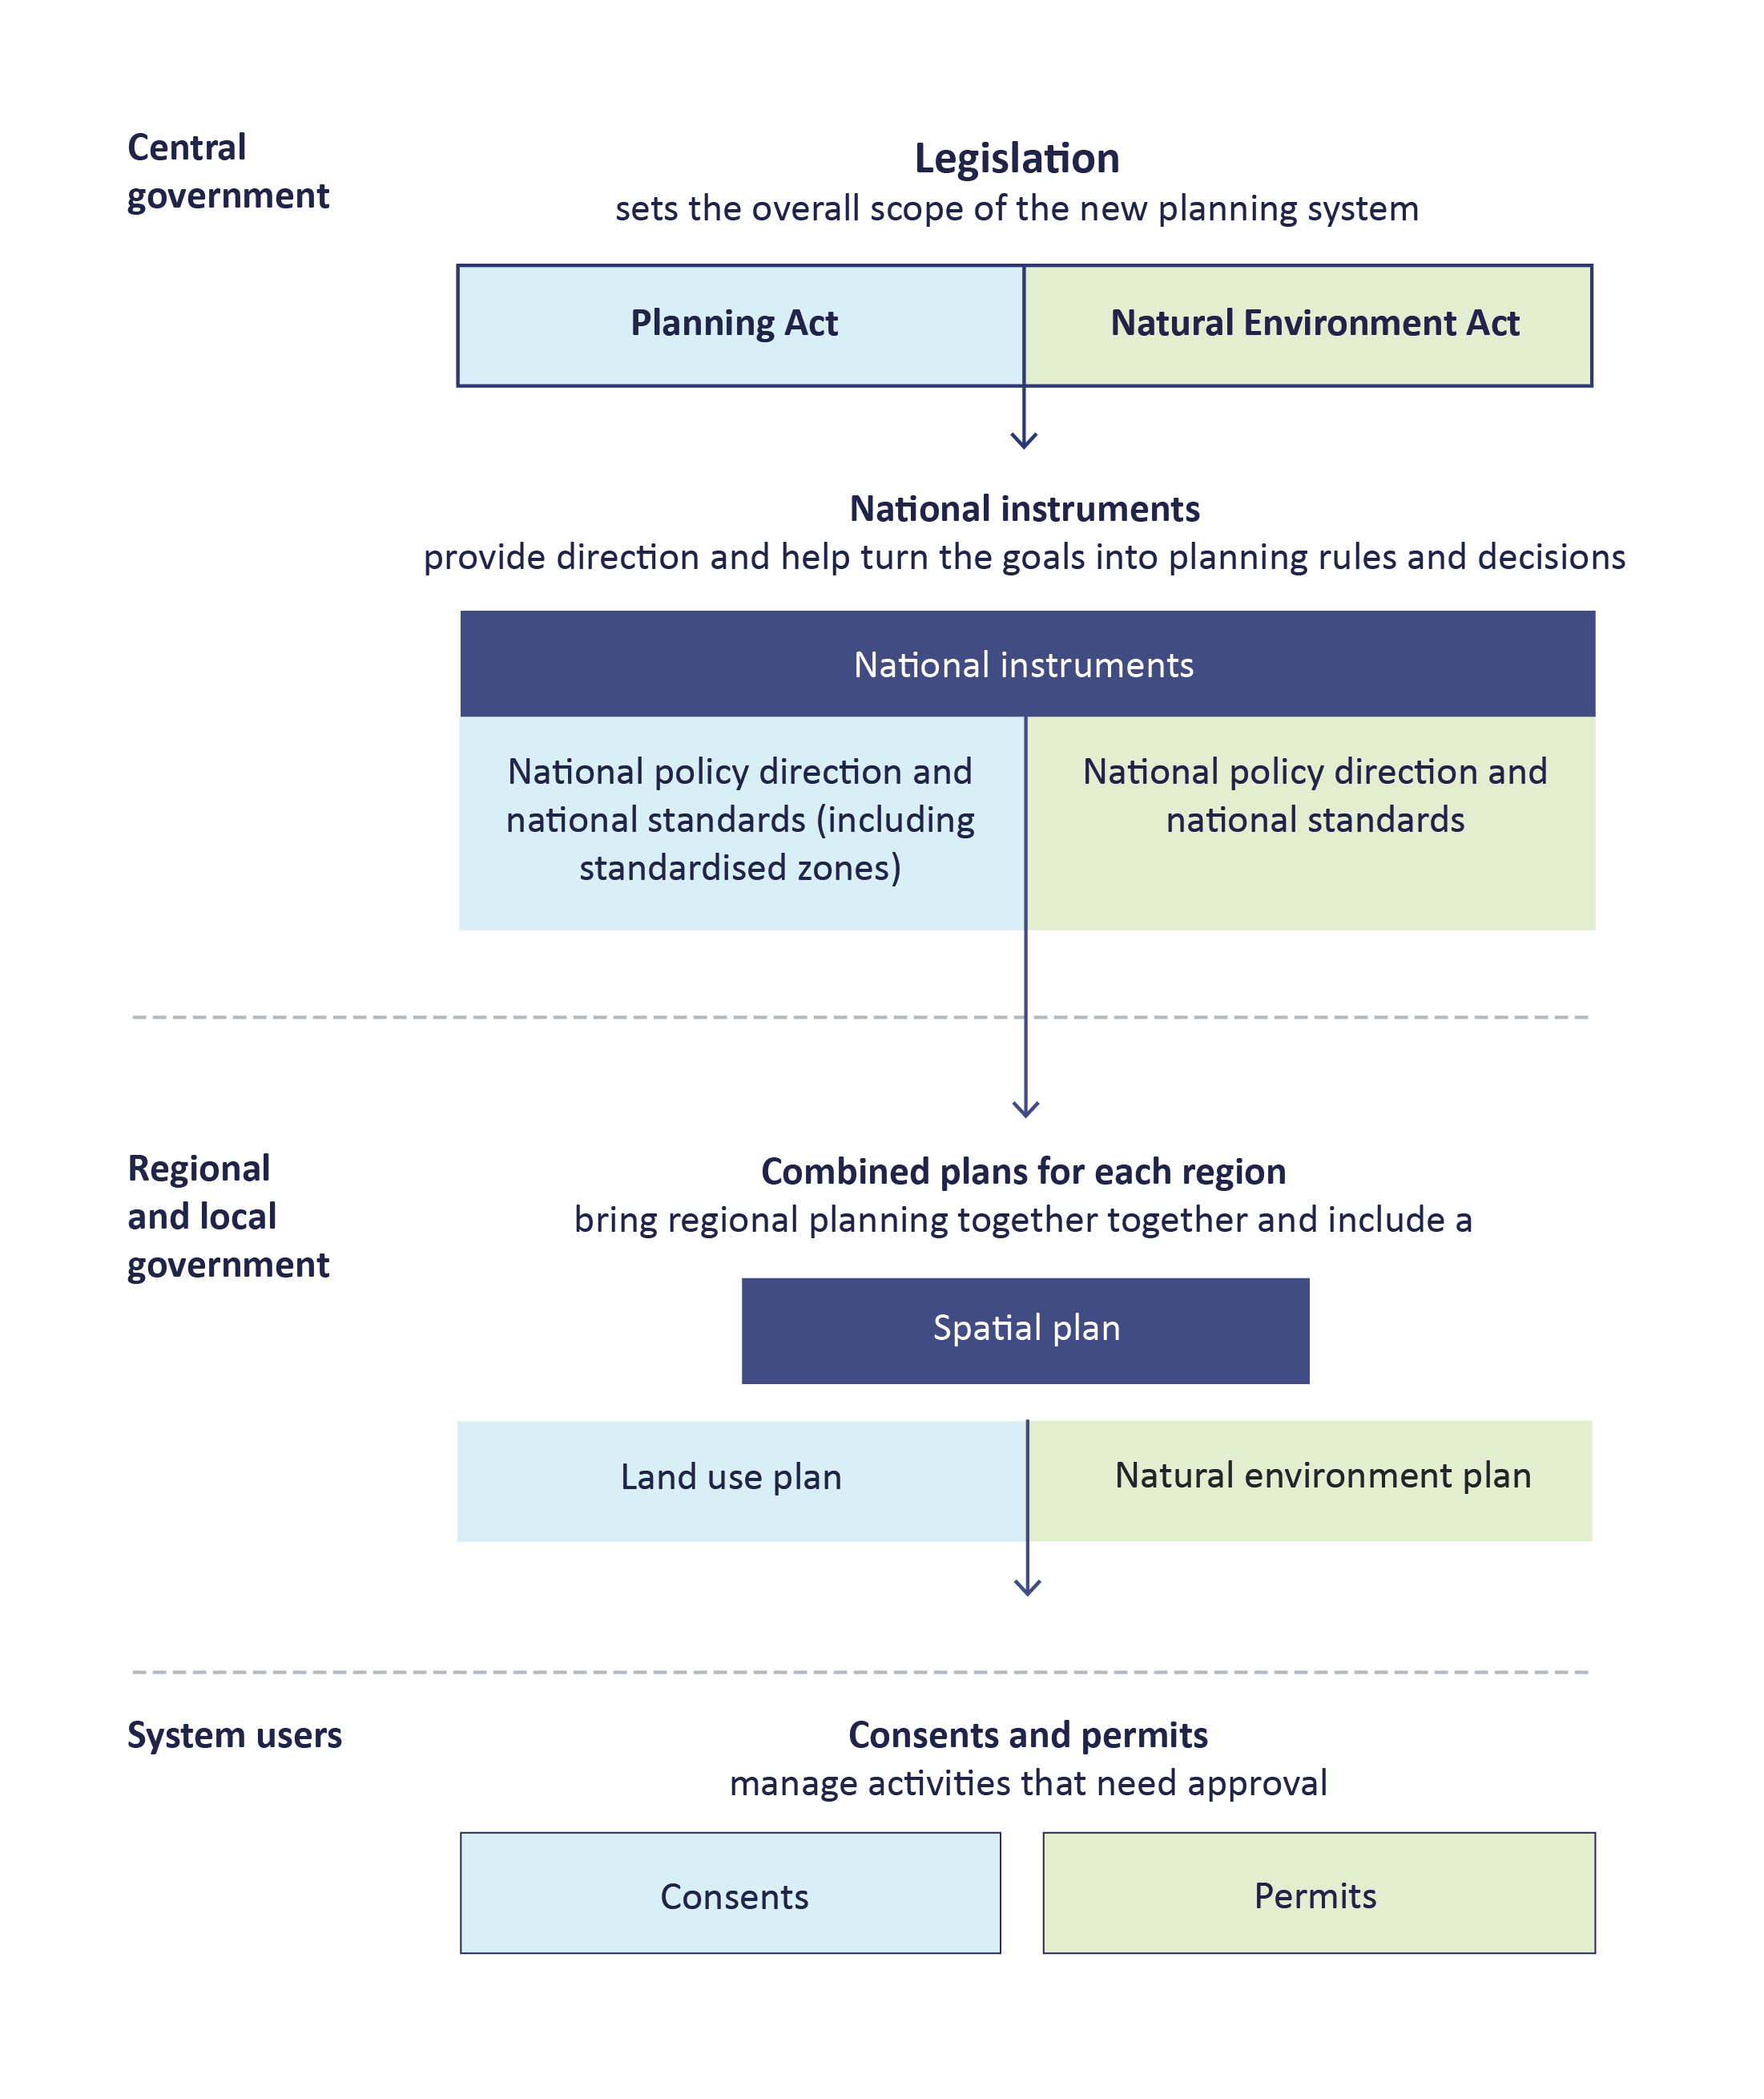
How the new planning system works
Figure 1 : System architecture diagram

Slide 5

What is different?
The new system places greater emphasis on:
The new system intends to reduce duplication and litigation, and provide greater certainty for communities, councils, developers and investors.
National Policy Direction
National standards
Regional spatial planning
Strategic decisions before consent processes begin

Slide 6

Supporting housing, infrastructure and growth
Better planning for future growth
The new system is designed to:
support housing growth
support infrastructure delivery
enable economic growth and change
create well-functioning urban and rural areas
enable competitive urban land markets.

Slide 7

Protecting what matters most
A stronger framework for environmental management
The system uses:
National direction
Environmental limits
Natural environment plans
Regional implementation

Slide 8
A nationally connected planning system
National policy direction
Working as one system
National standards
Nationally consistent data
The reforms are designed to work as a connected national system rather than a collection of local interpretations.
One connected
planning system
Regional e-plans
Shared digital services
Planning Tribunal and implementation support

Slide 9
Data and digital foundations
Investing in implementation | Budget 2026 investment supports:
Nationally consistent
planning information
Trusted environmental
and hazard data
Connected national
platform foundations
Shared digital
services
Common data
standards
The New Zealand
Flood Map

Slide 10
Connections with wider Government work
While each reform has its own purpose, they are connected by a common goal: improving the way decisions are made about the places where people live, work, move and invest.
Together, these reforms and the other core work programmes provide an opportunity to better align decisions that shape our future by supporting growth and development while protecting the natural systems that underpin New Zealand’s long-term prosperity and wellbeing.
Taking a more joined-up approach will help reduce fragmentation across systems, improve the coordination of planning, regulation, funding and delivery, and provide greater certainty for communities, councils, iwi, businesses and investors.
MCERT is leading a significant programme
of reform across the systems that shape
New Zealand’s cities, regions and environment, including planning, housing, transport and local government.

Slide 11
Timeline and what happens next
Year | Milestone
2026 | The Planning Bill and Natural Environment Bill are passed into law. The transition period starts one month after royal assent.
2027 | National policy direction (NPD) issued no later than 12 months after royal assent. National standards providing direction on the structure and form of regional spatial plans finalised within 12 months of royal assent (but not before NPD).
2028 | National standards relating to environmental limits finalised within 18 months after royal assent. National standards on standardised plan provisions finalised within 21 months after royal assent. Councils notify draft regional spatial plans within 21 months of royal assent.
2029 | Regional spatial plans must be decided within nine months after they are publicly notified. Councils notify proposed natural environment plans and proposed land use plans within nine months of regional spatial plan decisions. Once all proposed plans are notified, the Minister will recommend an Order in Council be made specifying the date the new legislation will apply (the specified transition date).
2030 | From the specified transition date, all notified plans have legal effect and the new system is fully ‘switched on’. Councils must decide land use plans and natural environment plans within 12 months of notifying them.
The transition will happen in stages, allowing councils, practitioners, businesses and communities time to prepare and adapt.
Existing plans, consents and processes will continue to operate under the RMA during the transition period while new planning tools, national direction and supporting systems are introduced.

Slide 12
Implementation roadmap
2026
2027
2028
2029
2030
Planning Bill and Natural Environment Bill – expected to be enacted September 2026​
Government consideration of Head Start outline proposals
Transition period and transitional consenting begins
Establishment of spatial plan committees, secretariats and process agreements
RMA plans and consenting stay in place until the new system takes over​
Public engagement on illustrative national policy direction in August 2026​
National policy direction issued no later than 12 months after the Bills become law (September 2027) ​
National standards, providing direction on the structure and form of regional spatial plans finalised within 12 months of enactment (e.g. September 2027) (but not before national policy direction)​
National standards relating to environmental limits finalised within 18 months after the Bills become law (e.g. March 2028)
National standards on standardised plan provisions finalised within 21 months after the Bills become law (e.g. June 2028)​
Councils notify draft regional spatial plans within 21 months of the Bills becoming law (e.g. June 2028)​
Regional spatial plans must be decided within 9 months after they are publicly notified (e.g. March 2029)​
Councils notify natural environment plans and land use plans within 9 months of regional spatial plan decisions (e.g. December 2029)
Once all plans are notified, the Minister will recommend an Order in Council be made specifying the date the new legislation will apply (the specified transition date)
From the specified transition date, all notified plans have legal effect and the new system is fully ‘switched on’ ​
Councils must decide land-use plans and natural environment plans within 12 months of notifying them.

Slide 13
Patai?
Questions

Slide 14
Ngā mihi nui
Thank you
Regional relationship teams
planning@mcert.govt.nz
For the latest updates, guidance and implementation resources:
planning.govt.nz

